Slide 1
Session 3
Module 5: Swing Advanced Controls
Module 6: Internationalization

Slide 2
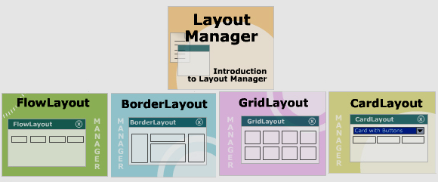
Module 3 Review

Slide 3
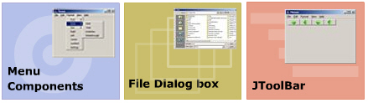
Module 4 Review

Slide 4
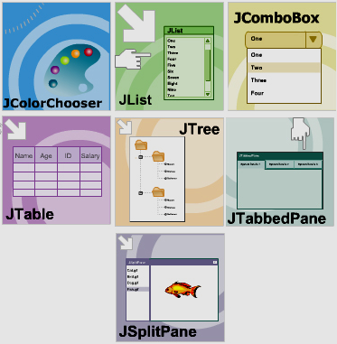
Module 5: Swing Advanced Controls
Objectives

Slide 5
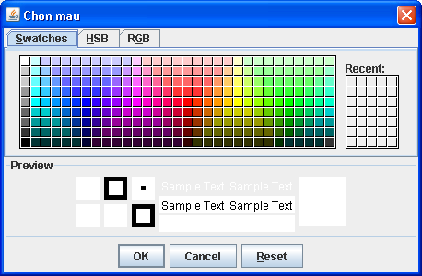
javax.swing.JColorChooser class
Swatches: sample colors
HSB: Hue, Saturation, Brightness
RGB: Red Green Blue
Constructors:
JColorChooser()
JColorChooser(java.awt.Color initColor)
Event handling:
javax.swing.event.ChangeEvent
javax.swing.event.ChangeListener
public void stateChanged(ChangeEvent e)
Methods:
ColorSelectionModel getSelectionModel()
Color getColor()
void setColor (Color c)
Color showDialog(Component container ,String title ,Color initColor)

Slide 6
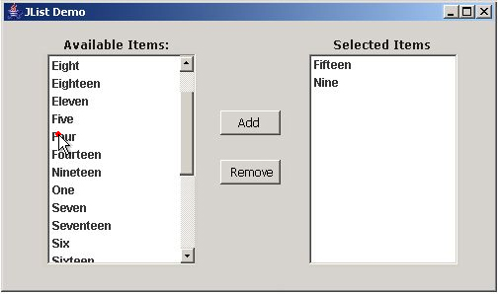
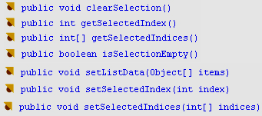

javax.swing.JList class
JList displays a groups of items in one or
more columns.
JList does not support scrolling inherently.
Add JList to a JScrollPane to support
scrolling functionality.
Constructors
JList()
JList ( Object[] dataItems)
JList ( Vector vectorItems)
Common used Methods
Event handling:
ListSelectionEvent
ListSelectionListener
public void valueChanged(ListSelectionEvent e)

Slide 7


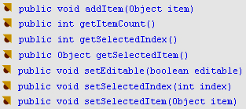
javax.swing.JComboBox class
Event handling:
ActionEvent
ActionListener
public void actionPerformed(ActionEvent e)
ItemEvent
ItemListener
public void itemStateChanged(ItemEvent e)
Common used methods

Slide 8
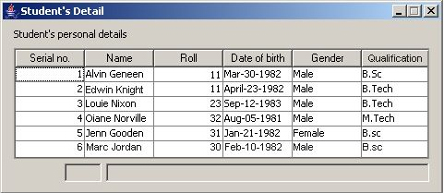
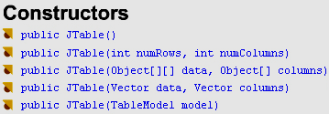

javax.swingJTable class
Column Headers
data
Event handling:
MouseEvent
MouseListener
public void mouseClicked( MouseEvent e)
Common used methods

Slide 9
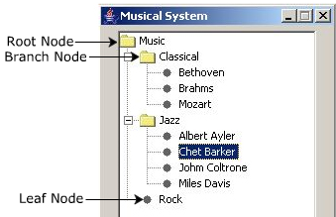

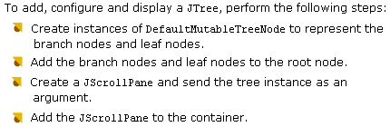
javax.swing.JTree class
Event Handling
javax.swing.event.TreeSelectionEvent
javax.swing.event.TreeSelectionListener
public void valueChanged(TreeSelectionEvent e)
javax.swing.event.TreeExpansionEvent
javax.swing.event.TreeExpansionListener
public void treeExpanded(TreeExpansionEvent e)
public void treeCollapsed(TreeExpansionEvent e)
javax.swing.event.TreeWillExpandEvent
javax.swing.event.TreeWillExpandListener
public void treeWillExpand(TreeWillExpandEvent e)
public void treeWillCollapse(TreeWillExpandEvent e)

Slide 10
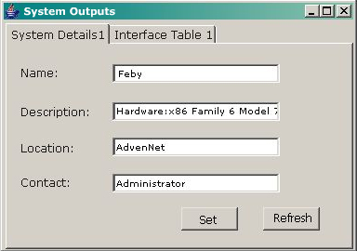
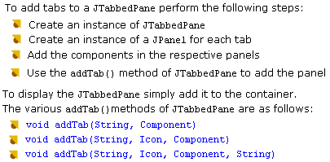
javax.swing.JTabbedPane class
Constructors
JTabbedPane()
JTabbedPane( int direction)
Event Handling
ChangeEvent
ChangeListener
public void stateChanged(ChangeEvent e

Slide 11
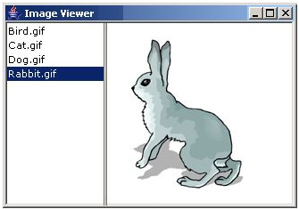
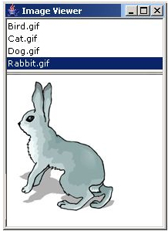

javax.swing.JSplitPane class
Constructors:
JSplitPane() // side by side, no continuous layout
JSplitPane(int direction )
JSplitPane(int direction , boolean continuous)
JSplitPane(int direction, boolean continuous,
Component comp1, Component comp2)

Slide 12
Module 5 Summary

Slide 13

Module 6: Internationalization

Slide 14
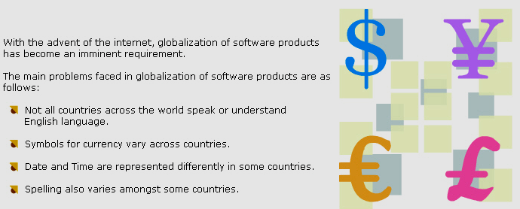


Need of Internationalization
X
Internationalization
Component Captions
Formatting numbers
Formatting date and time
Messages
Where should you use internationalization?

Slide 15
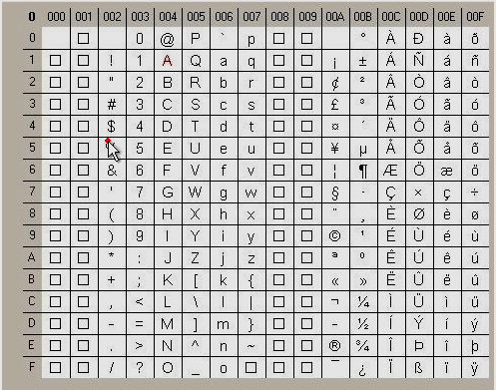
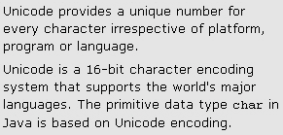

Unicode

Slide 16




Creating a Properties File
Examples

Slide 17


Defining Locale: Locale Class
Example:

Slide 18
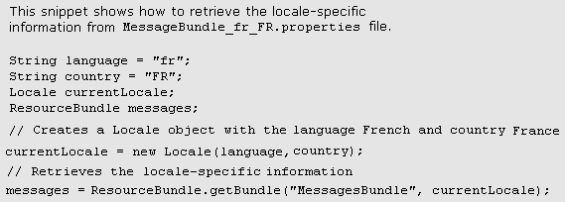

ResourceBundle Class
public static ResourceBundle getBundle (String propertiesFileName,
Locale obj)
Fetching the text from ResourceBundle

Slide 19
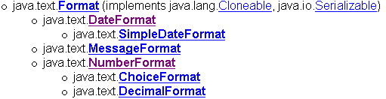
Classes for formatting

Slide 20
Class java.text.NumberFormat:
Format numbers, currencies, percentages
Abstract class
static NumberFormat getInstance() // default locale
static NumberFormat getInstance(Locale inLocale)
static NumberFormat getNumberInstance()
static NumberFormat getNumberInstance(Locale inLocale)
static NumberFormat getIntegerInstance()
static NumberFormat getIntegerInstance(Locale inLocale)
static NumberFormat getCurrencyInstance()
static NumberFormat getCurrencyInstance(Locale inLocale )
static NumberFormat getPercentInstance()
static NumberFormat getPercentInstance(Locale inLocale)
String format(double number)
String format(long number)
get/set minimumFractionDigits
get/set maximunFractionDigits
get/set minimumIntegerDigits

Slide 21
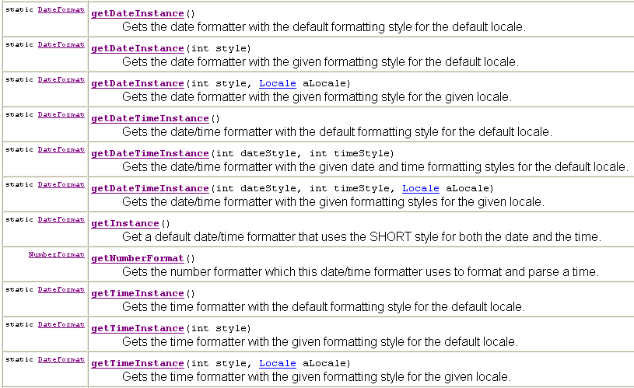
public asbtract class java.text.DateFormat

Slide 22
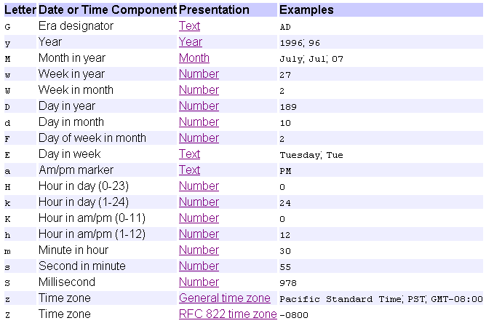
Class public java.text.SimpleDateFormat

Slide 23
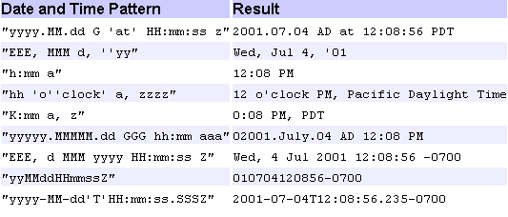
Class public java.text.SimpleDateFormat

Slide 24
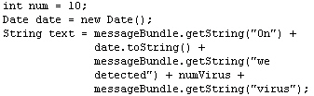
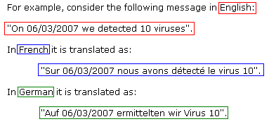
Class java.text.MessageFormat

Slide 25
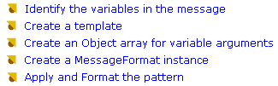
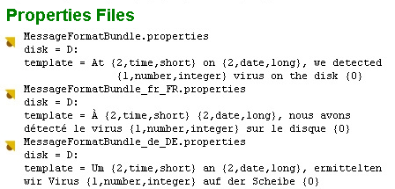
Procedure to use MessageFormat class

Slide 26
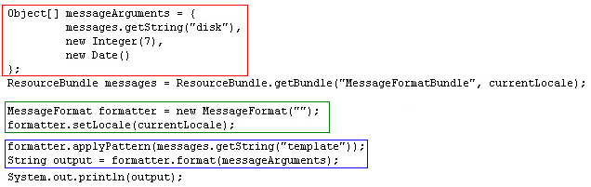
MessageFormat class

Slide 27
Module 6 Summary

